Slide 1
From what we did previously (in TRS)
~11 cm scanned in Ind CT at higher resolution
Smith #1 core at depth 11,147.5–11,147.9 ft. The images represent: A) Core photograph with scale in cm, B) 3D volumetric CT scan, C) Orthographic planes through the CT volume

Slide 2
From what we did previously (in TRS)
Visualization of features from the Smith #1 core at depth 11,147.7–11,147.9 ft. The images represent: A) orthographic planes through the CT volume, B) 3D volume of sand and silt in orthographic planes showing soft sediment deformation and filled burrows, and C) complete 3D volume with features distinguished by the colors from the legend.

Slide 3
From what we did previously (in TRS)
Representation of open fractures in the Smith #1 core at depth 11,147.5–11,147.9 ft. The images display: A) orthographic planes through the CT volume, B–C) 3D volume of fractures in orthographic planes shown at respective 0°, 120°, and 240° rotations.
Still missing many small fractures

Slide 4
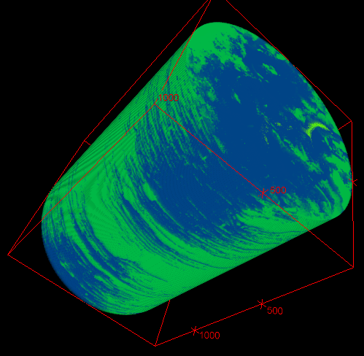
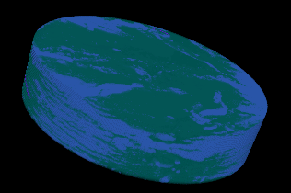
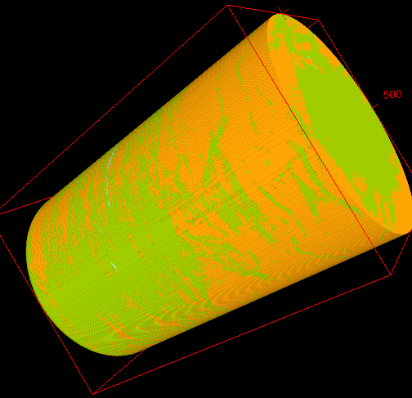
Taking Ind data we can get relative material proportions
Split into three segments for processing
Top: 1.04% fractures, 30.26% lighter sands and silts, 68.70% darker shales
Middle: 0.07% fractures, 27.95% lighter sands and silts, 71.98% darker shales
Bottom: 0.04% fractures, 29.25% lighter sands and silts, 70.71% darker shales

Slide 5
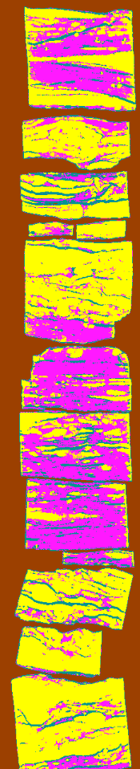
Medical CT data – lower res and quality
Section that has highest TOC’s
Using entire volumes
  11,160-11,162 ft
  Sandy/silty burrows 56.6%
  Darker shale 29.41%
  Fractures 13.99%
  Using center sub-volume
    Sandy/silty burrows 49.85%
    Darker shale 36.80%
    Fractures 13.34%
2.82 and 2.90, Amy Close, 11,161
Highest – 4.40 USGS report 11,161.5, SW redo 3.74
11,160–11,162 ft

Slide 6
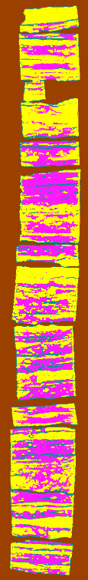
Med CT
Section that has next highest TOC’s
Using entire volumes
  11,141-11,143 ft
  Sandy/silty burrows 55.48%
  Darker shale 31.22%
  Fractures 13.30%
  Using center sub-volume
    Sandy/silty burrows 49.29%
    Darker shale 37.98%
    Fractures 12.73%
Weatherford 4.75, 11,141.9
11,141–11,143 ft

Slide 7
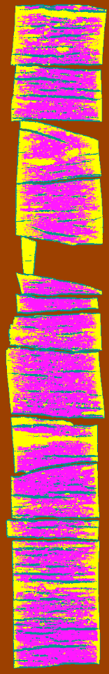
Med CT
1.29, Weatherford, 11,197.3
1.63, Amy Close, 11,198
Using entire volumes
  11,197-11,200 ft
  Sandy/silty burrows 36.44%
  Darker shale 45.60%
  Fractures 17.95%
  Using center sub-volume
    Sandy/silty burrows 19.5%
    Darker shale 61.73%
    Fractures 18.75%
Harris, 2.44 and 2.31, 11,199
Sam TS 2.35%, and 2.20% 11,200
11,197–11,200 ft

Slide 8
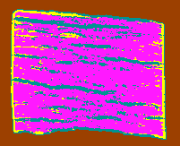
Med CT
Using entire volumes
  11,200-11,200.5 ft
  Sandy/silty burrows 11.30%
  Darker shale 68.79%
  Fractures 19.93%
  Using center sub-volume
    Sandy/silty burrows 2.65%
    Darker shale 76.93%
    Fractures 20.42%
1.83 and 1.94, Amy Close, 11,120
11,200–11,200.5 ft

Slide 9
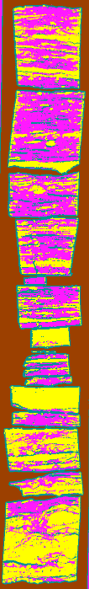
Med CT
Using entire volumes
  11,143-11,1145 ft
  Sandy/silty burrows 42.02%
  Darker shale 35.27%
  Fractures 22.70%
  Using center sub-volume
    Sandy/silty burrows 38.92%
    Darker shale 42.70%
    Fractures 18.38%
2.20 and 1.49, Amy Close, 11,144
11,143–11,145 ft

Slide 10
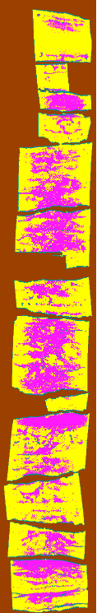
Med CT – not a great scan, poor contrast
Using entire volumes
  11,135-11,1137 ft
  Sandy/silty burrows 69.25%
  Darker shale 23.58%
  Fractures 7.17%
  Using center sub-volume
    Sandy/silty burrows 55.43%
    Darker shale 38.09%
    Fractures 6.49%
Sam VR 2.17%, 11,136.5
11,135–11,137 ft

Slide 11
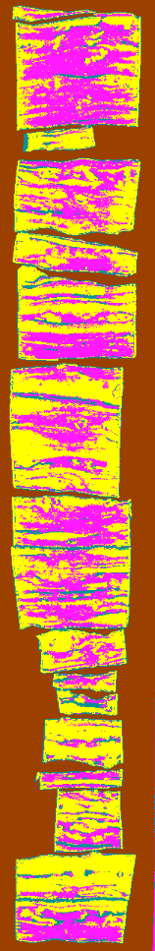
Med CT
Using entire volumes
  11,138-11,1140 ft
  Sandy/silty burrows 75.93%
  Darker shale 19.32%
  Fractures 4.74%
  Using center sub-volume
    Sandy/silty burrows 88.73%
    Darker shale 10.44%
    Fractures 0.82%
1.59 and 1.41, Amy Close, 11,139
1.82, SW, 11,139.5
11,138–11,140 ft

Slide 12
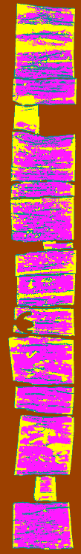
Med CT
Using entire volumes
  11,149-11,151 ft
  Sandy/silty burrows 32.12%
  Darker shale 52.77%
  Fractures 15.11%
1.78 and 1.90, Amy Close, 11,150
2.16, SW, 11,150.50
Sam 2.12%, 11,150.8
11,149–11,151 ft

Slide 13
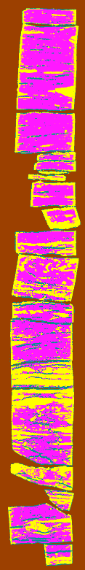
Med CT
Using entire volumes
  11,152-11,154 ft
  Sandy/silty burrows 36.87%
  Darker shale 51.43%
  Fractures 11.70%
1.93 and 1.81, Amy Close, 11,153
11,152–11,154 ft

Slide 14
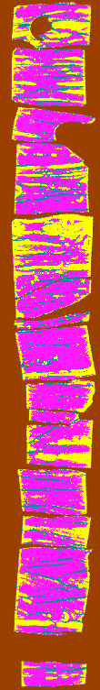
Med CT
1.51, SW 11,155.50
Using entire volumes
  11,154-11,157 ft
  Sandy/silty burrows 33.49 %
  Darker shale 54.03 %
  Fractures 12.48 %
  Using center sub-volume
    Sandy/silty burrows 21.89%
    Darker shale 64.06%
    Fractures 14.06%
? 1.36, Weatherford, 11,155.9
11,154–11,157 ft

Slide 15
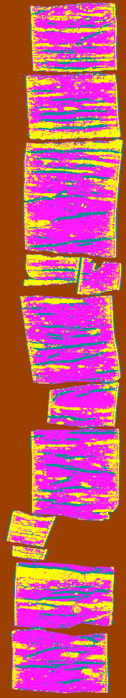
Med CT
1.51, Weatherford, 11,191
Using entire volumes
  11,191-11,193 ft
  Sandy/silty burrows 30.54%
  Darker shale 54.06%
  Fractures 15.40%
  Using center sub-volume
    Sandy/silty burrows 21.4%
    Darker shale 62.97%
    Fractures 15.65%
11,191–11,193 ft

Slide 16
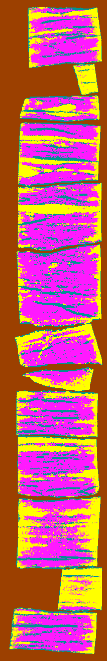
Med CT
Using entire volumes
  11,194-11,197 ft
  Sandy/silty burrows 35.32%
  Darker shale 49.62%
  Fractures 15.05%
  Using center sub-volume
    Sandy/silty burrows 20.14%
    Darker shale 62.73%
    Fractures 17.14%
11,194–11,197 ft

Slide 17
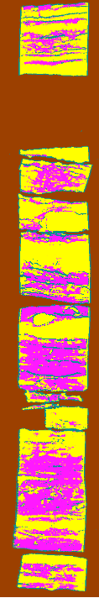
Med CT
Using entire volumes
  11,146-11,1148 ft
  Sandy/silty burrows 55.4%
  Darker shale 29.24%
  Fractures 15.36%
11,146–11,148 ft

Slide 18
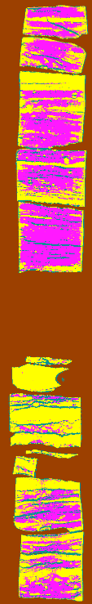
Med CT
Using entire volumes
  11,157-11,159 ft
  Sandy/silty burrows 49.58%
  Darker shale 36.69%
  Fractures 13.73%
  Using center sub-volume
    Sandy/silty burrows 42.17%
    Darker shale 46.02%
    Fractures 11.80%
11,157–11,159 ft

Slide 19
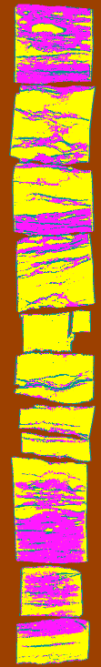
Med CT
Using entire volumes
  11,162-11,165 ft
  Sandy/silty burrows 55.99%
  Darker shale 29.30%
  Fractures 14.71%
  Using center sub-volume
    Sandy/silty burrows 52.32%
    Darker shale 36.29%
    Fractures 11.39%
11,162–11,165 ft

Slide 20
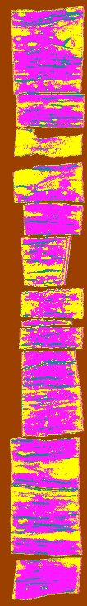
Med CT
Using entire volumes
  11,166-11,168 ft
  Sandy/silty burrows 38.18%
  Darker shale 50.65%
  Fractures 11.17%
  Using center sub-volume
    Sandy/silty burrows 29.90%
    Darker shale 60.44%
    Fractures 12.66%
1.73, Weatherford, 11167.3
11,166–11,168 ft

Slide 21
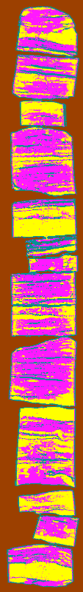
Med CT
Using entire volumes
  11,168-11,171 ft
  Sandy/silty burrows 36.29%
  Darker shale 43.40%
  Fractures 20.32%
  Using center sub-volume
    Sandy/silty burrows 33.23%
    Darker shale 51.04%
    Fractures 16.73%
11,168–11,171 ft

Slide 22
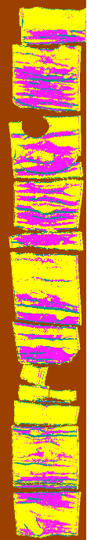
Med CT
0.81, SW, 11171.3
Using entire volumes
  11,171-11,174 ft
  Sandy/silty burrows 65.67%
  Darker shale 24.58%
  Fractures 9.75%
  Using center sub-volume
    Sandy/silty burrows 55.24%
    Darker shale 33.46%
    Fractures 11.30%
11,171–11,174 ft

Slide 23
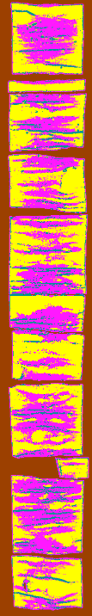
Med CT
Using entire volumes
  11,174-11,177 ft
  Sandy/silty burrows 53.26%
  Darker shale 35.88%
  Fractures 10.85%
  Using center sub-volume
    Sandy/silty burrows 41.66%
    Darker shale 48.37%
    Fractures 9.97%
11,174–11,177 ft

Slide 24
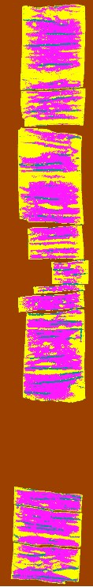
Med CT
Using entire volumes
  11,177-11,179 ft
  Sandy/silty burrows 44.14%
  Darker shale 46.26%
  Fractures 9.59%
  Using center sub-volume
    Sandy/silty burrows 27.07%
    Darker shale 60.67%
    Fractures 12.26%
1.21, Weatherford, 11,178.3
1.28, SW, 11,178.4
11,177–11,179 ft

Slide 25
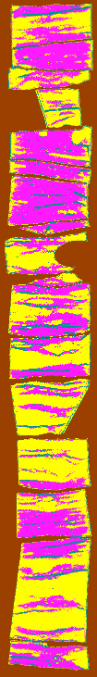
Med CT
Using entire volumes
  11,179-11,181 ft
  Sandy/silty burrows 53.55%
  Darker shale 35.63%
  Fractures 10.82%
  Using center sub-volume
    Sandy/silty burrows 43.14%
    Darker shale 47.88%
    Fractures 8.98%
11,179–11,181 ft
Harris 1.34 and 1.15, 11,181

Slide 26
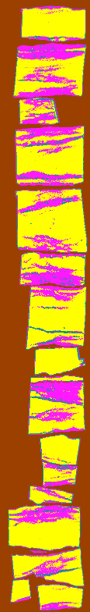
Med CT
Using entire volumes
  11,182-11,184 ft
  Sandy/silty burrows 67.94%
  Darker shale 23.32%
  Fractures 8.74%
  Using center sub-volume
    Sandy/silty burrows 65.12%
    Darker shale 28.87%
    Fractures 6.02%
0.16, SW, 11183.5
11,182–11,184 ft

Slide 27
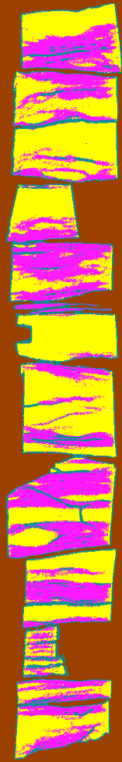
Med CT
Using entire volumes
  11,184-11,187 ft
  Sandy/silty burrows 54.41%
  Darker shale 31.71%
  Fractures 14.80%
  Using center sub-volume
    Sandy/silty burrows 49.28%
    Darker shale 40.22%
    Fractures 10.50%
11,184–11,187 ft

Slide 28
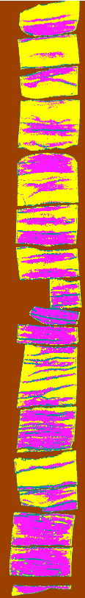
Med CT
Using entire volumes
  11,187-11,190 ft
  Sandy/silty burrows 52.88%
  Darker shale 34.17%
  Fractures 12.95%
  Using center sub-volume
    Sandy/silty burrows 44.42%
    Darker shale 42.96%
    Fractures 12.63%
? 0.45 and 0.13, Amy, 11189
11,187–11,190 ft

Slide 29
Measured TOC %

