Slide 1

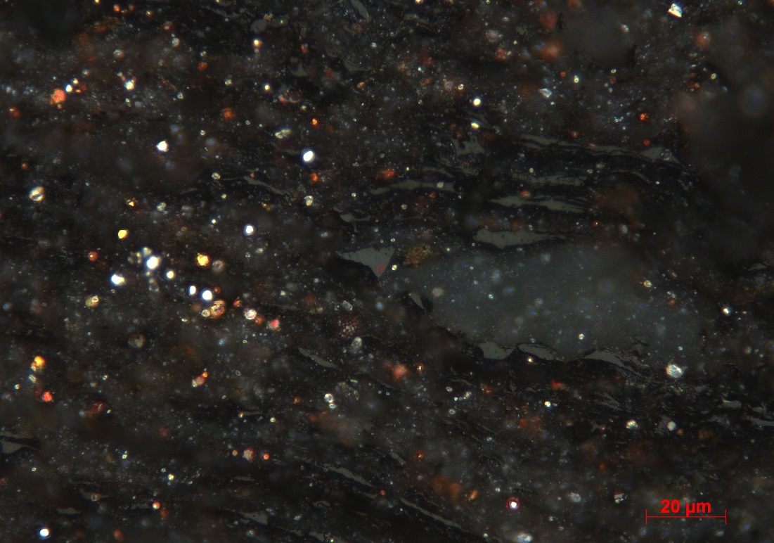
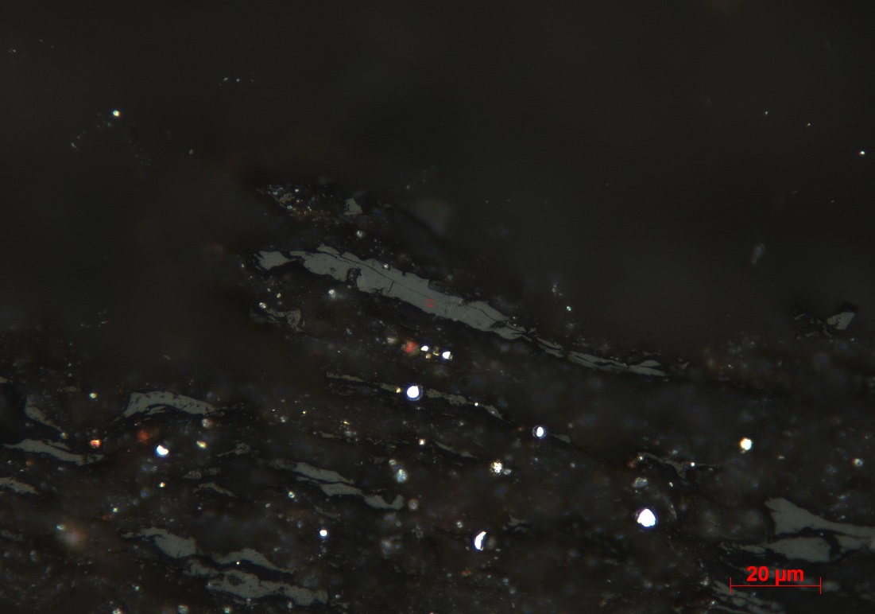
PHOTOMICROGRAPHS
Cabot Oil & Gas Corporation : Project HH-75056; J.P. Smith
Sample 101734408 (1CK), 11136.5’: Reddish/orangey tinge to mildly oxidised framboidal pyrite.
Sample 101734408 (1CK), 11136.5’’): Pyrobitumen lens (centre) with a reflectance value of 1.91% Br_{o} from the central measuring circle.
Weatherford Laboratories - Geochemical Services Group - 143 Vision Park Blvd.- Shenandoah - TX 77384

Slide 2
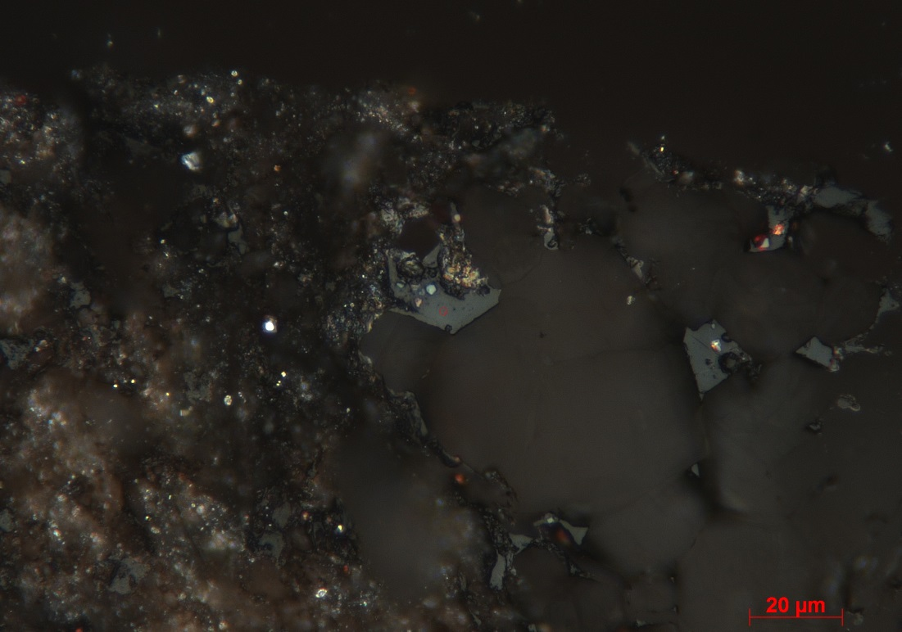
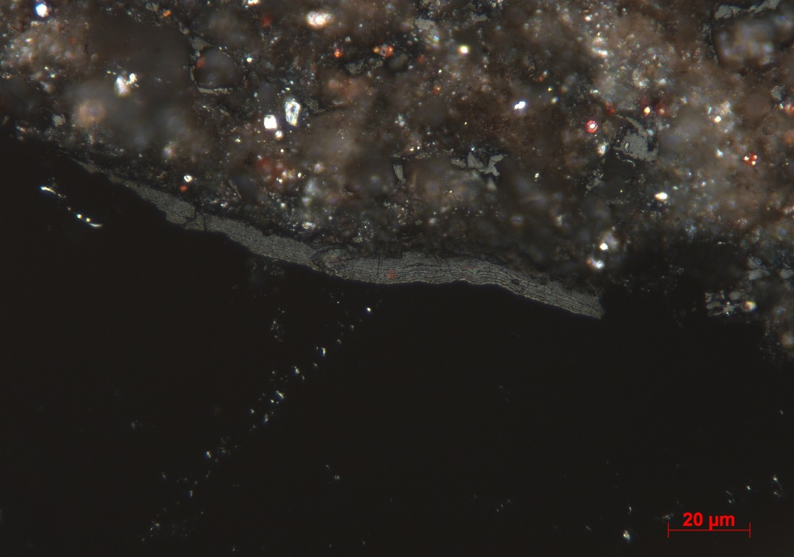
PHOTOMICROGRAPHS
Cabot Oil & Gas Corporation : Project HH-75056; J.P. Smith
Sample 101734440 (17CK), 11200.0’): ‘Angular’ pyrobitumen filling void within a mineral grain with a reflectance value of 2.28% Br_{o} from the central measuring circle.
Sample 101734440 (17CK), 11200.0’): Peridermal-like layer (centre) with a reflectance value of 1.04% R_{o} from central measuring circle. Reflectance value probably too low and unreliable due to the fine alternating gray and dark pattern. N.B. Light level boosted for illustrative purposes.
Weatherford Laboratories - Geochemical Services Group - 143 Vision Park Blvd.- Shenandoah - TX 77384

